Slide 1
Banker’s Algorithm Questions

Slide 2
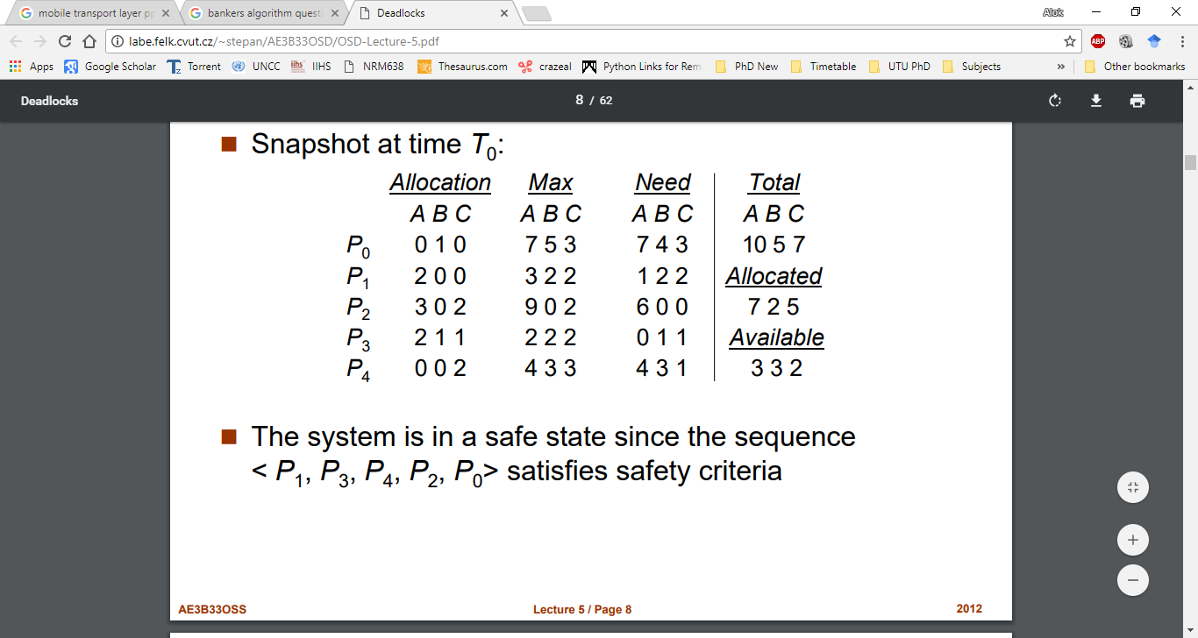
Question 1
5 processes P0 through P4 ; 3 resource types A (10 instances), B (5instances, and C (7 instances). Suppose following is the machine’s state at T0, then find need matrix, currently available resources and safe sequence.

Slide 3
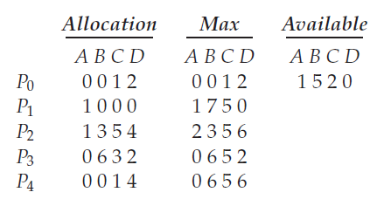
Question 2
Consider the following snapshot of a system:
Answer the following questions using the banker’s algorithm:
a. What is the content of the matrix Need?
b. Is the system in a safe state?
c. If a request from process P1 arrives for (0,4,2,0), can the request be granted immediately?

Slide 4
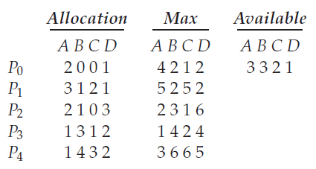
Question 3
Consider the following snapshot of a system:
Answer the following questions using the banker’s algorithm:
Illustrate that the system is in a safe state by demonstrating an order in which the processes may complete.
If a request from process P1 arrives for (1, 1, 0, 0), can the request be granted immediately?
If a request from process P4 arrives for (0, 0, 2, 0), can the request be granted immediately?

Slide 5
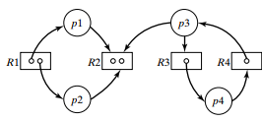
Question 4
Consider the following reusable resource graph:
Which processes are blocked?
Which processes are deadlocked?
Is the state a deadlock state? Generate Allocation, max and need matrices.

Slide 6
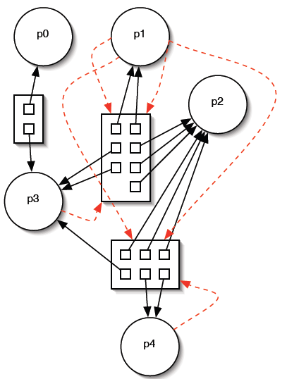
Question 5
The diagram shown below is a resource allocation graph. Does it contain a deadlock? If so, say which processes are involved in the deadlock. If not, indicate a safe sequence by which each process could run to termination, assuming that it will not request any more resources.

